Slide 1
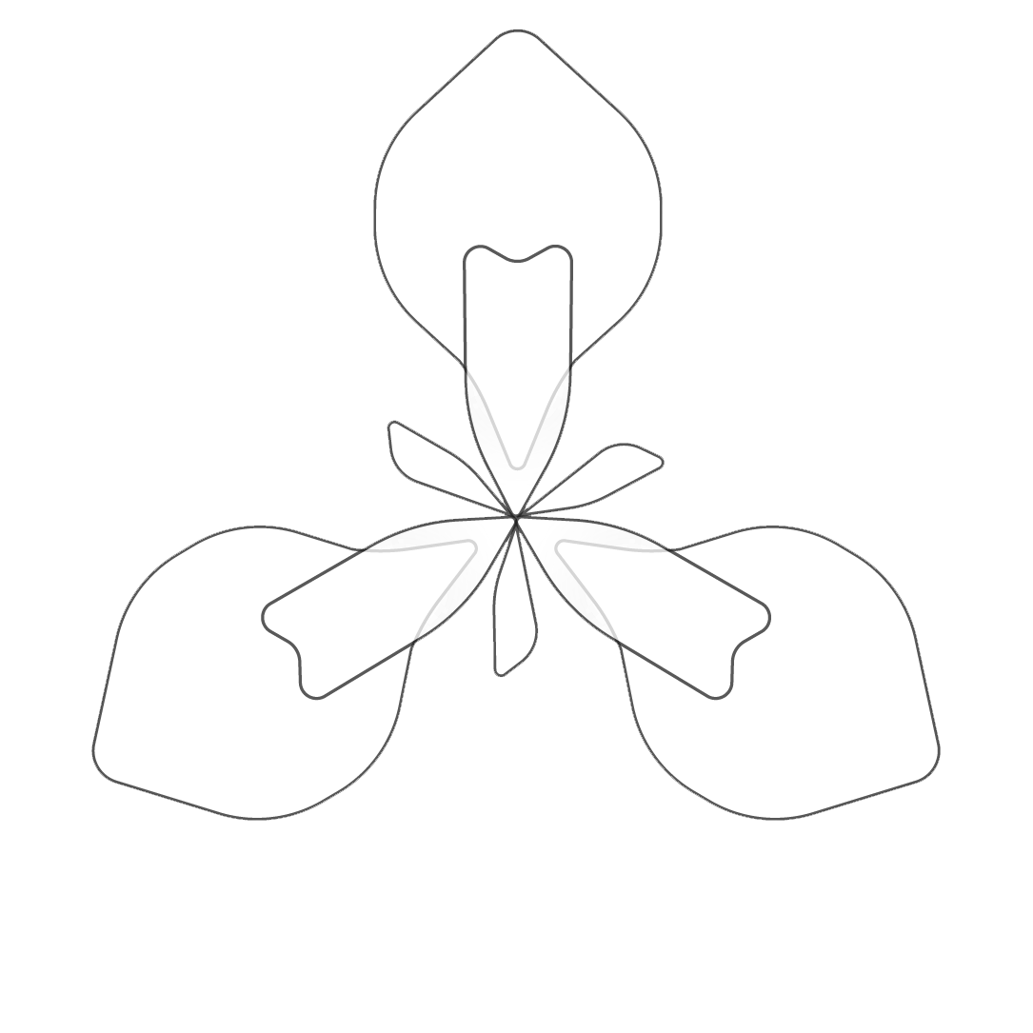
IrisBG – Collection Management
Coffee Chats
October 12th, 2021
© 2021 Compositae AS

Slide 2
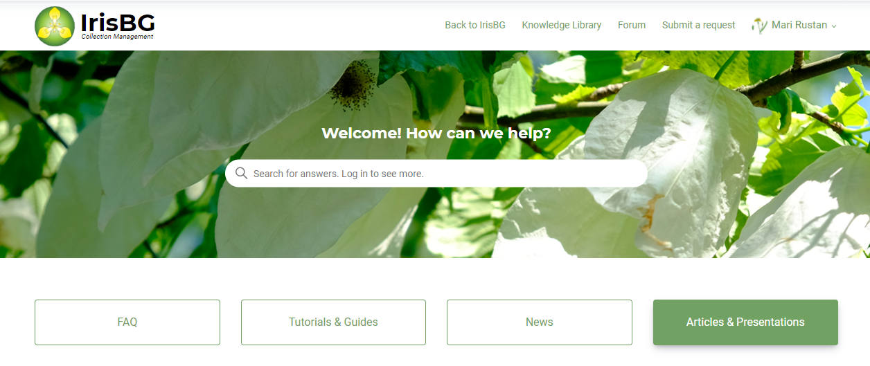
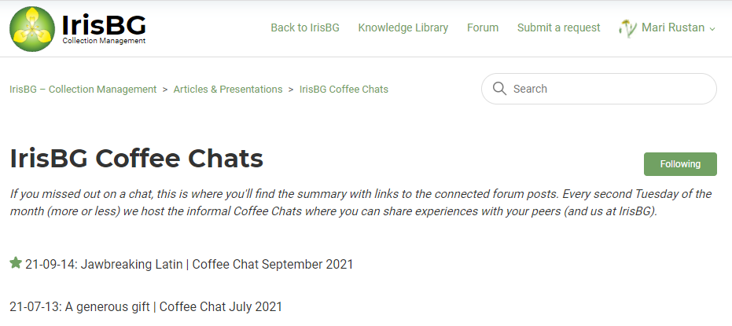
Coffee Chats
August 10th, 2021
Agenda
Coffee Chats
Knowledge Library
Official YouTube channel
Forum
💡Tip! Follow topics in the Knowledge Library
to get notified when something new is published.
IrisBG | Coffee Chats, September 14th, 2021
© 2021 Compositae AS

Slide 3
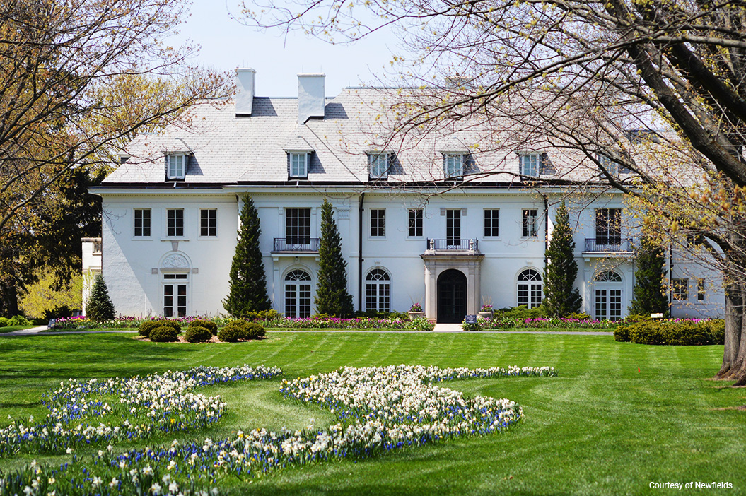
Coffee Chats
August 10th, 2021
Agenda
Intro
Plant Records Challenge: “Custom Attributes at Newfields” Jaime Frye of Newfields
“Customizing fields at National Trust” Alison Crook of National Trust UK
Open chat
Newfields. Courtesy of Newfields.
IrisBG | Coffee Chats, October 12th, 2021
© 2021 Compositae AS

Slide 4
RECAP
Coffee Chats are for you
Get in touch if…
You have something you’d like to get the community’s input on
You have a topic you would like us to address
You want us to demo functionality
You have feedback on how to improve
IrisBG | Coffee Chats, October 12th, 2021
© 2021 Compositae AS

Slide 5
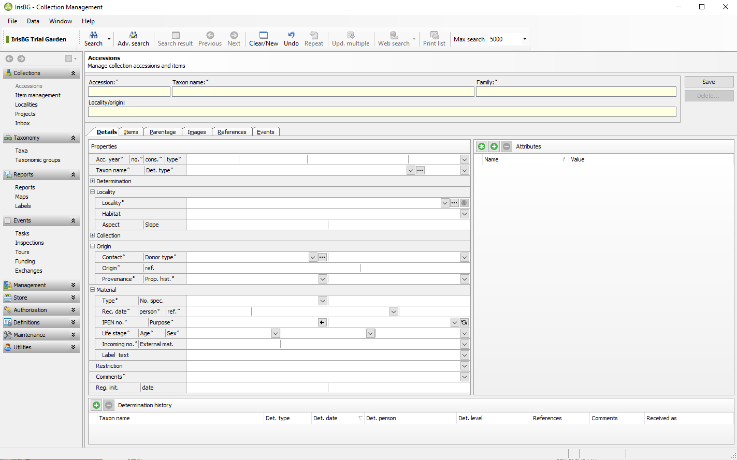
EFFICIENCY TIP
Custom Attributes
Add Custom Attributes to the Details tab in:
Accession screen
Taxa screen
IrisBG | Coffee Chats, October 12th, 2021
© 2021 Compositae AS

